Slide 1

VEL TECH HIGH TECH Dr. RANGARAJAN Dr. SAKUNTHALA ENGINEERING COLLEGE An Autonomous Institution
Department of Computer Science and Engineering
Mini Project Review
EXPLORING THE EVOLUTION OF HUMAN RESOURCE ANALYTICS AND ITS IMPACT ON ORGANISATIONAL PERFORMANCE
AKALYA.S (VH-12292) SUPERVISOR:
HARINIPRIYA.V (VH-12338) Ms.S.KAVITHA B.E,M.E.,
DATE:27.6.2024 ASSISTANT PROFESSOR
II Year ,Computer Science and Engineering

Slide 2
Exploring the evolution of human resource analytics and its impact on organisational performance
INTRODUCTION:
Human resources analytics involves the use of data and statistical analysis to gain insights into various aspects of an organization's workforce. This field focuses on collecting and interpreting data related to human resources processes, employee performance, and overall organizational dynamics.
By leveraging analytics, businesses can make informed decisions to optimize their HR strategies, improve employee engagement, and enhance overall organizational performance.

Slide 3
ABSTRACT:
Human resources data analysis is crucial for boosting organizational performance.
Sophisticated analytics offer insights into employee productivity, engagement, and satisfaction.
Power BI and Tableau into HR analytics facilitates comprehensive data visualization, enabling HR professionals to create interactive dashboards and reports.
Utilizing HR analytics optimizes workforce management, identifies trends, and enables targeted interventions.
Overall, leveraging analytics in HR aligns human capital with strategic objectives, enhancing organizational performance.

Slide 4
OBJECTIVE:
Examine the evolution of HR analytics and its impact on organizational performance, uncovering insights to inform strategic decisions and enhance overall effectiveness.

Slide 5
S.N0 | YEAR | TITTLE&AUTHOR | DESCRIPTION | METHODOLOGY | PROPOSED SYSTEM
1 | 2023 | RESEARCH ON HR ANALYTICS USING POWER BI AND MACHINE LEARNING. Prof. Ashvini Ganesh Bhosale , Ms. Rashmi Mrugank Shah, Ms. Ankita Anil Patil, Ms. Anisha Anil Khamka. | Research on HR analytics using Power BI and machine learning explores how advanced data visualization techniques combined with predictive analytics can optimize HR processes, enhance decision-making, and improve workforce management strategies. | Objective Definition: Clearly define research goals for HR analytics using Power BI and machine learning. Data Preparation and Integration: Clean, preprocess, and integrate HR data from various sources. Power BI Dashboards: Develop interactive Power BI dashboards to visualize key HR metrics. Machine Learning Integration Embed machine learning models in Power BI for real-time insights. Communication and Iteration: Communicate findings effectively and iterate for continuous improvement. | Define Goals: Clarify objectives, such as analyzing employee turnover or performance. Data Utilization: Collect and preprocess HR data, ensuring accuracy and compliance. Power BI Visualization: Use Power BI for interactive data visualization and exploration. Machine Learning Models: Train models for predictive analytics, focusing on relevant features. Inference and Communication: Extract insights, present findings through Power BI dashboards, and ensure ongoing improvement.

Slide 6
S.N0 | YEAR | TITTLE&AUTHOR | DESCRIPTION | METHODOLOGY | PROPOSED SYSTEM
2 | 2023 | Personalized human resource management via HR analytics and artificial intelligence: Theory and implications Xiaoyu Huang , Fu Yang , Jiaming Zheng , Cailing Feng , Lihua Zhang | This research delves into how integrating artificial intelligence with HR analytics can revolutionize personnel management by offering personalized insights, optimizing employee engagement, and shaping strategic HR policies based on predictive modeling and data-driven decision-making. | Review: Explore existing theories on personalized HR, HR analytics, and AI in HR. Interviews: Talk to HR professionals for real-world insights and challenges. Analytics: Use HR data and AI algorithms to identify patterns in performance and satisfaction. Surveys: Validate findings and gather broader employee perspectives. Implementation: Integrate AI insights into HR strategies, considering employee feedback. Monitoring: Continuously assess and adjust strategies based on evolving data. | Theory: Theoretical foundations support personalized HR via HR analytics and AI. HR Analytics: Uncover patterns in data for insights into employee performance and satisfaction. AI Implications: Automation and personalization enhance HR efficiency and employee experience. Combined Impact: Integration of analytics and AI promises effective, tailored HR management. Organizational Dynamics: Implementation likely influences organizational culture toward employee-centricity. Continuous Improvement: Ongoing adjustments based on data ensure continual enhancement.

Slide 7
S.N0 | YEAR | TITTLE&AUTHOR | DESCRIPTION | METHODOLOGY | PROPOSED SYSTEM
3 | 2022 | Human Resource Analytics using Power Bi Visualization Tool. Mohammad amir , Simhari and Suneetha manne | Human Resource Analytics using Power BI Visualization Tool focuses on leveraging interactive data visualizations to extract actionable insights from HR data, enabling organizations to make informed decisions, enhance workforce productivity, and drive strategic initiatives effectively. | Data Collection: Gather HR data comprehensively. Power BI Model: Build a structured data model. Visualize Metrics: Use Power BI for clear metric visualizations. Dashboards: Create interactive user-friendly dashboards. Share and Iterate: Publish reports, iterate for ongoing improvement. | Power BI reveals performance trends. Identifies turnover factors. Visualizations enhance HR metric understanding. Dashboards offer a holistic workforce view. Regular report sharing informs stakeholders. Iterative feedback ensures ongoing HR strategy improvement.

Slide 8
S.N0 | YEAR | TITTLE&AUTHOR | DESCRIPTION | METHODOLOGY | PROPOSED SYSTEM
4 | 2022 | HR Analytics and its Impact on Organizations Performance Mr. Hritik Kale, Dr. Dilip Aher, Dr. Nilesh Anute | HR Analytics and its Impact on Organizational Performance investigates the correlation between data-driven HR insights and organizational success, demonstrating how strategic analytics can optimize workforce management, improve employee retention, and drive business outcomes effectively. | Data Collection: Gather diverse HR data. Analysis Framework: Define key performance metrics. Tool Implementation: Utilize HR analytics tools. Model Development: Build analytical models. Visualizations: Create clear visual representations. Feedback Loop: Iterate based on insights and feedback | Strategic Insights: HR analytics offers strategic organizational insights. Performance Optimization: Identifies areas for performance enhancement. Data-Driven Decisions: Facilitates data-driven decision-making. Resource Allocation: Optimizes resource allocation and workforce management. Continuous Improvement: Enables ongoing enhancement through iterative analysis.

Slide 9
EXISTING SYSTEM:
An integrated suite offering modules for core HR, talent management, and workforce analytics.
Power BI is versatile business intelligence tool that organizations can use to create HR analytics dashboards and reports.
While not HR-specific, Tableau is a popular data visualization tool that many HR departments use to create interactive and shareable dashboards.
Provides solutions for recruitment, onboarding, performance management, and employee engagement with analytics features.

Slide 10
PROPOSED SYSTEM:
Establish a centralized database for storing accurate and up-to-date employee information, including personal details, skills, and performance history.
Implement tools for continuous performance monitoring, offering insights into individual and team achievements, and identifying areas for improvement.
Conduct regular surveys to measure employee satisfaction, identify concerns, and gauge overall engagement levels within the organization.
Track the impact of training programs on employee skills and performance, ensuring alignment with organizational goals.
Provide accessible dashboards for HR professionals and management to visualize key metrics in real-time, facilitating informed decision-making.
Identify high-potential employees and create succession plans to ensure a smooth transition in key roles.
Analyze HR-related costs, including recruitment expenses, training costs, and turnover-related expenses, to optimize budget allocation.

Slide 11
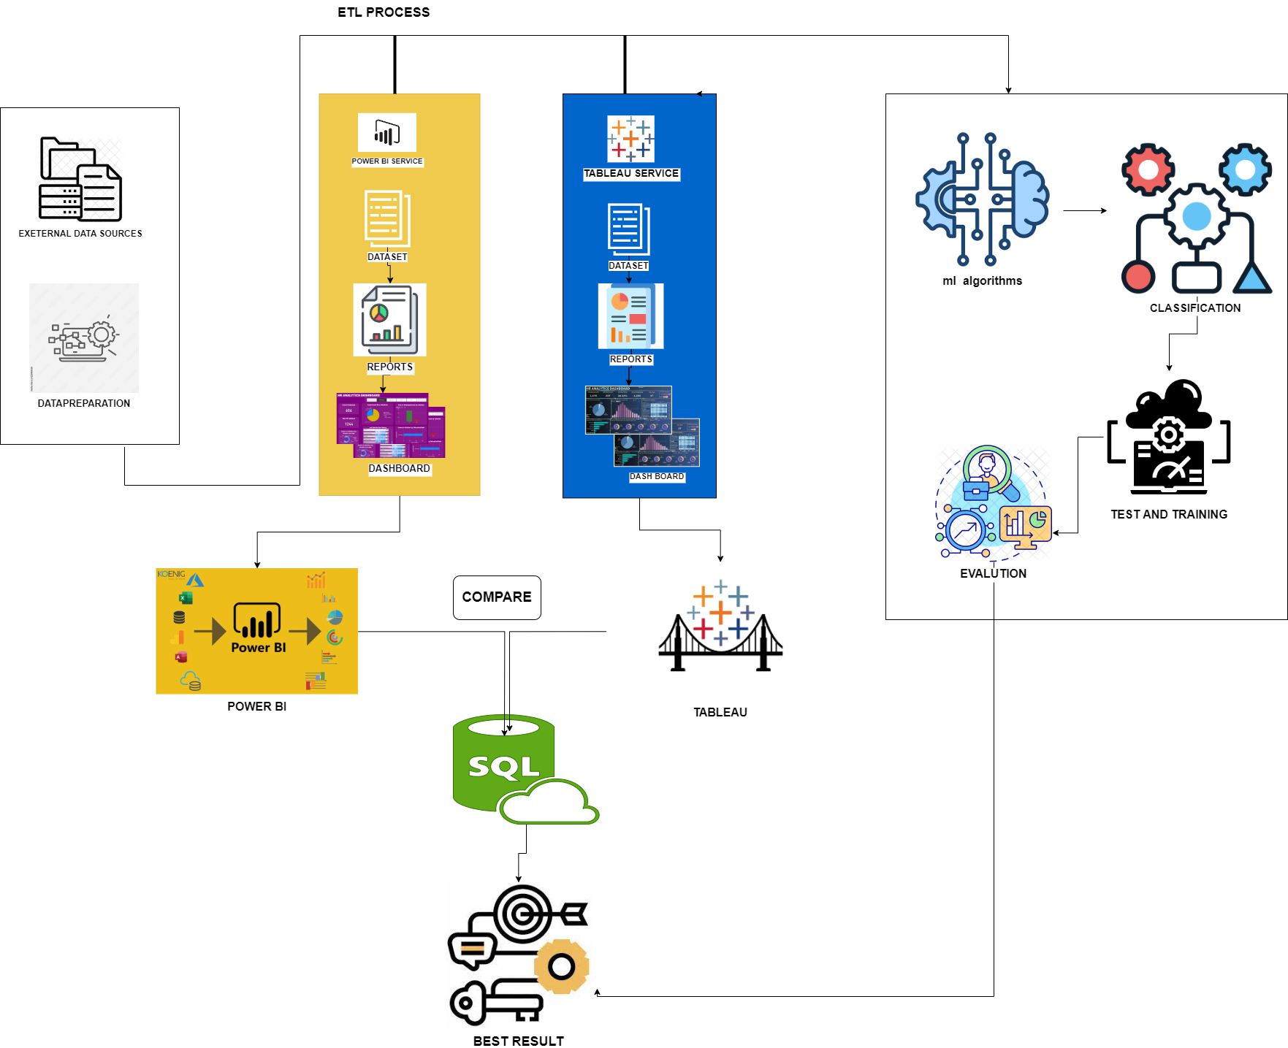
BLOCK DIAGRAM:

Slide 12
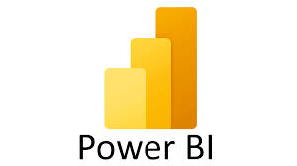

Slide 13
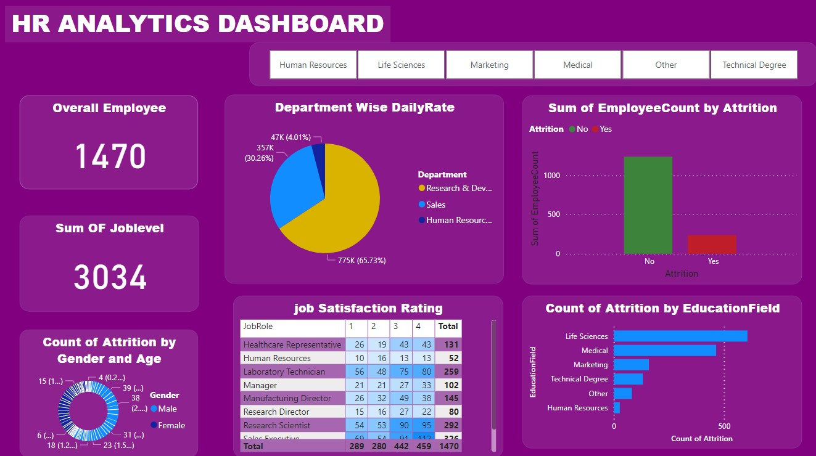
IMPLEMENTATION:

Slide 14
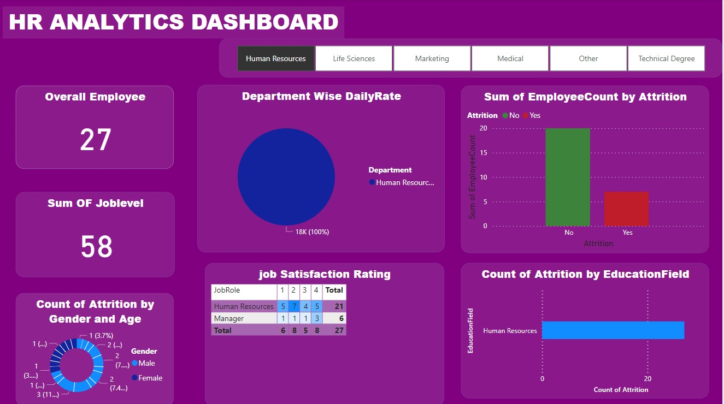

Slide 15
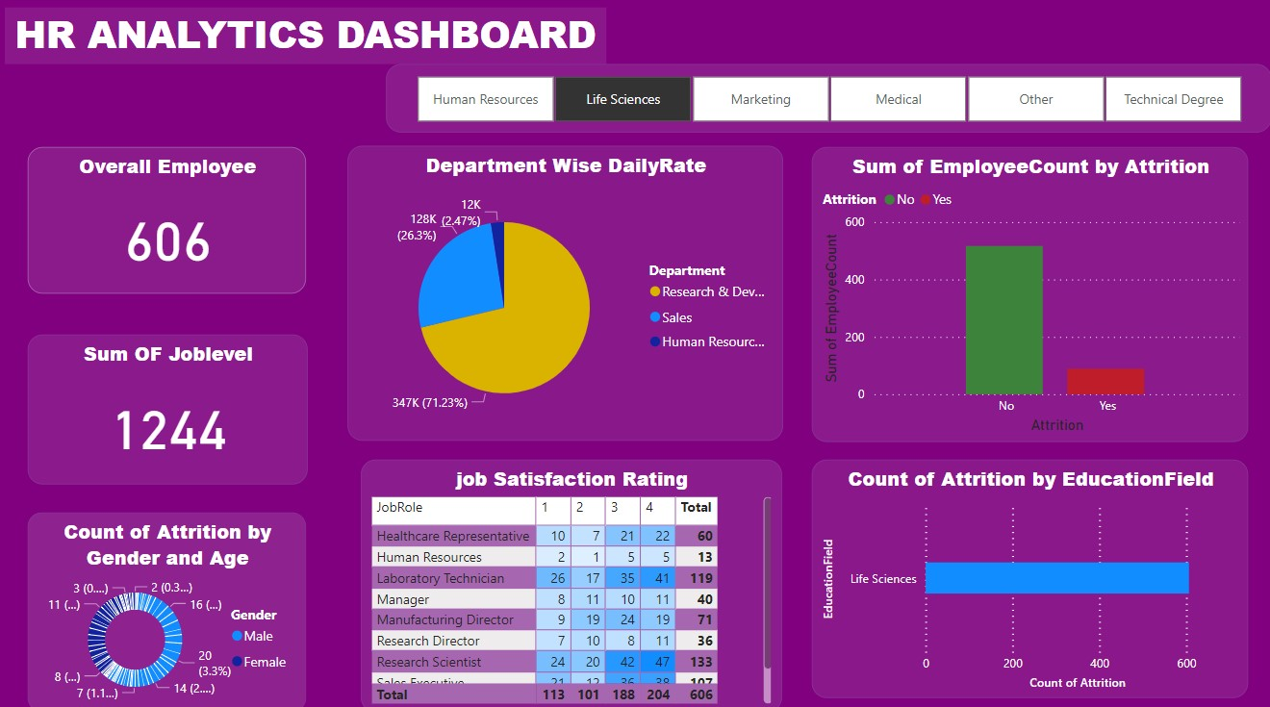

Slide 16
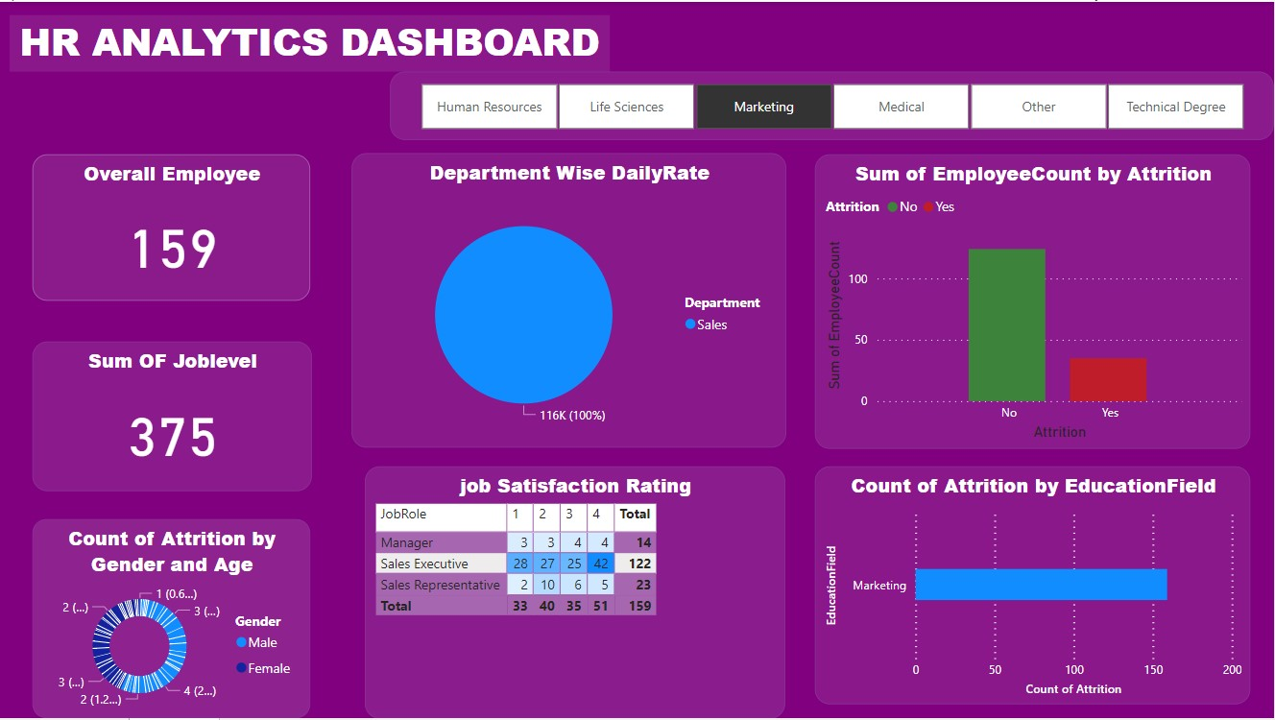

Slide 17
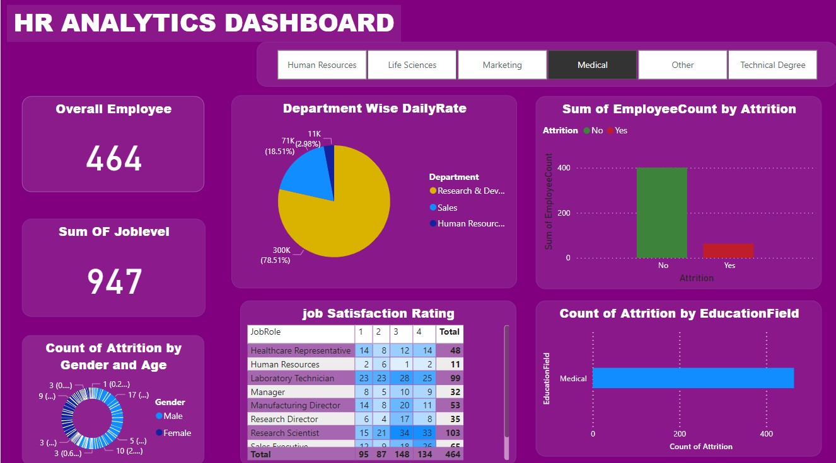

Slide 18


Slide 19
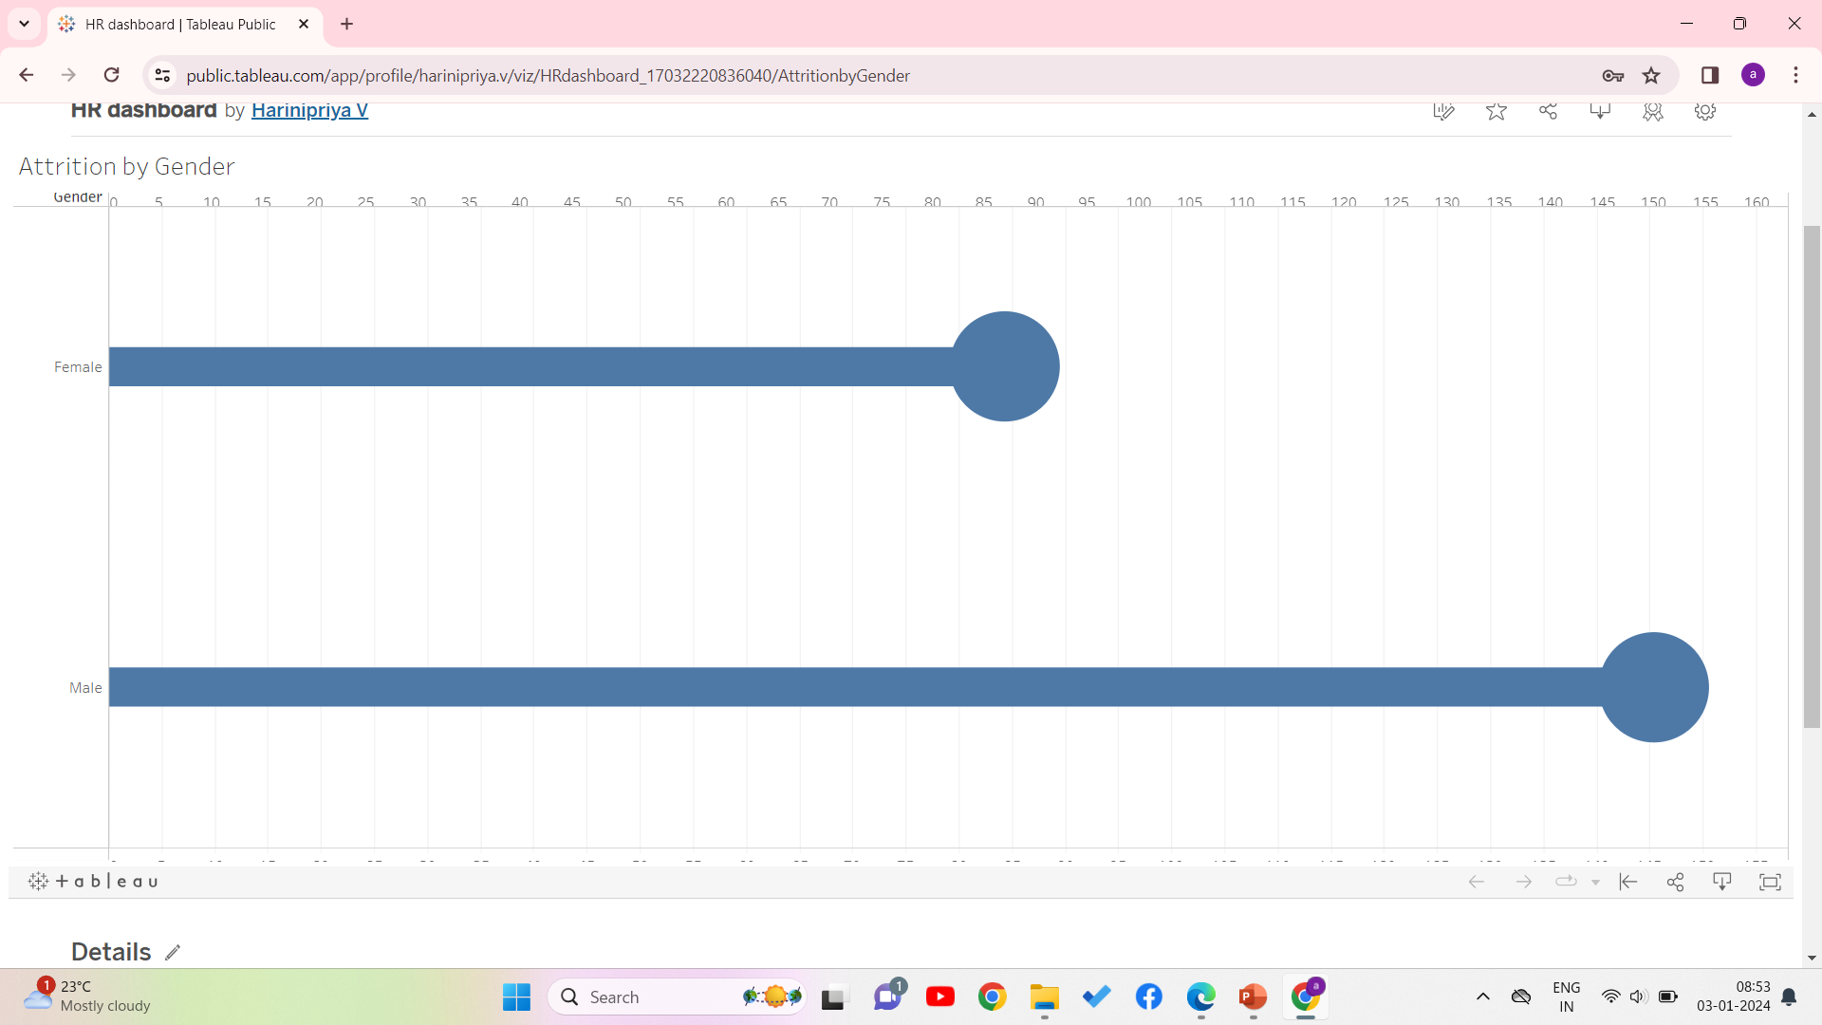

Slide 20
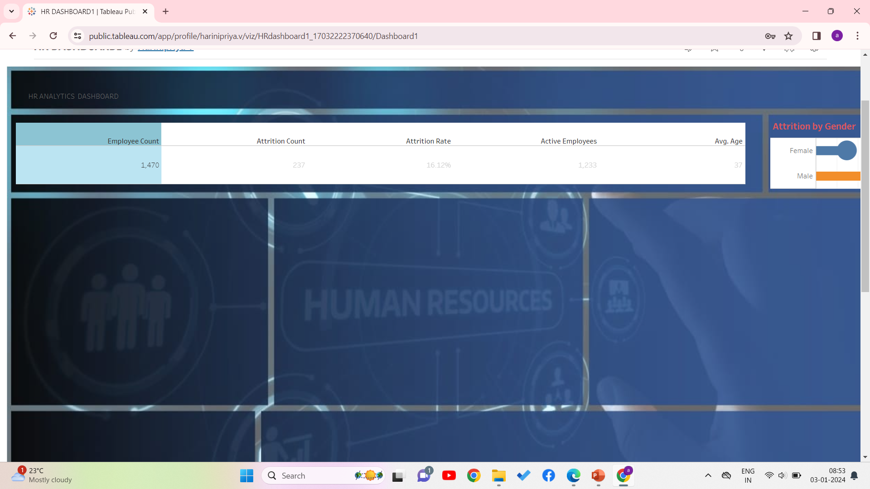

Slide 21
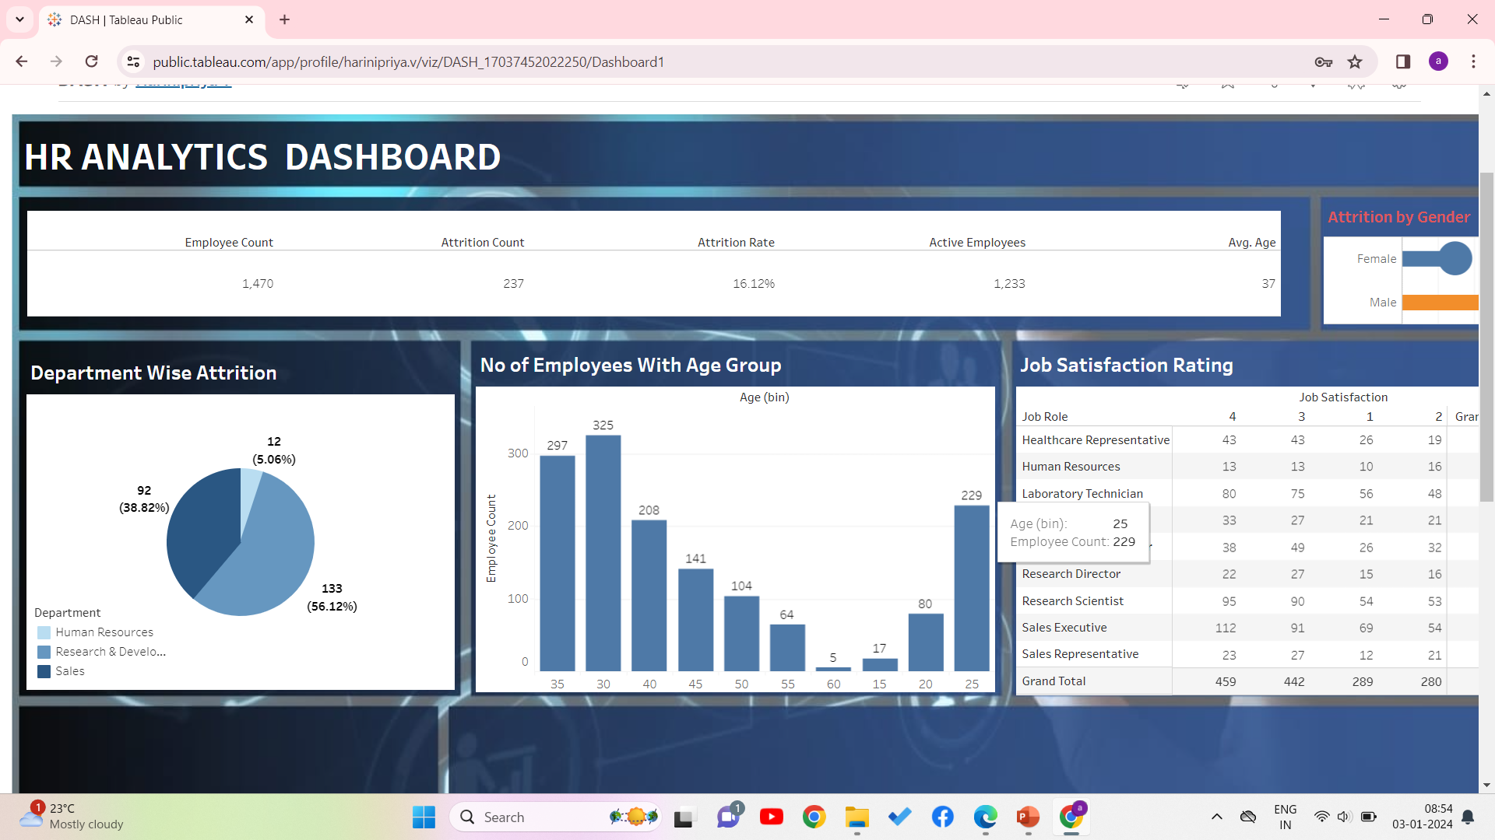

Slide 22
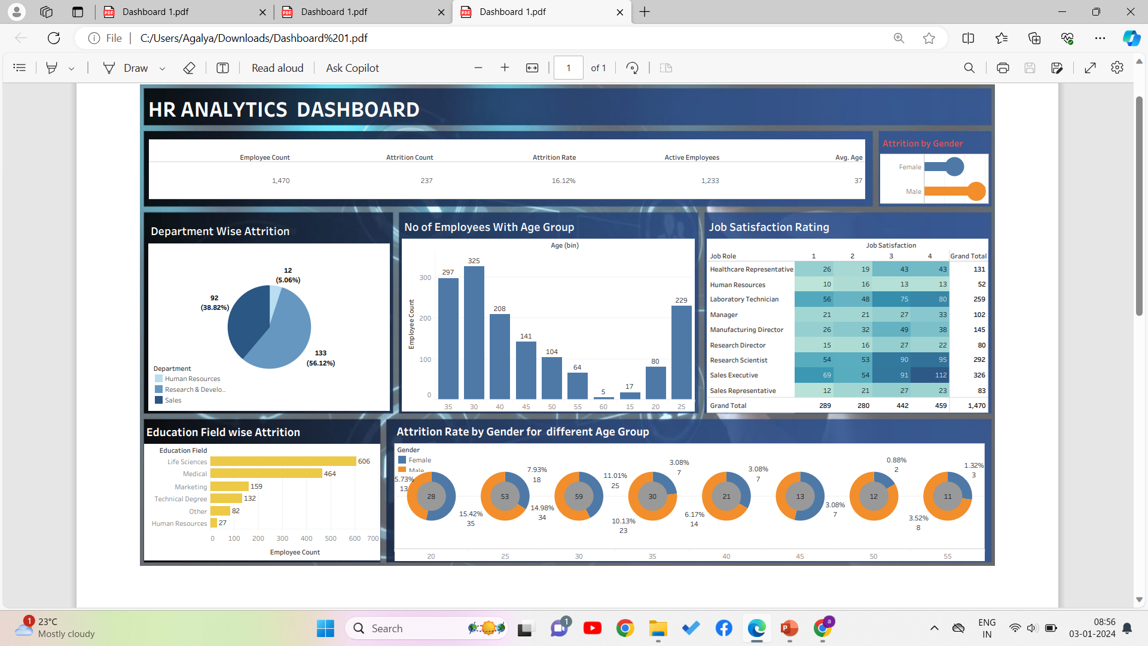

Slide 23


Slide 24
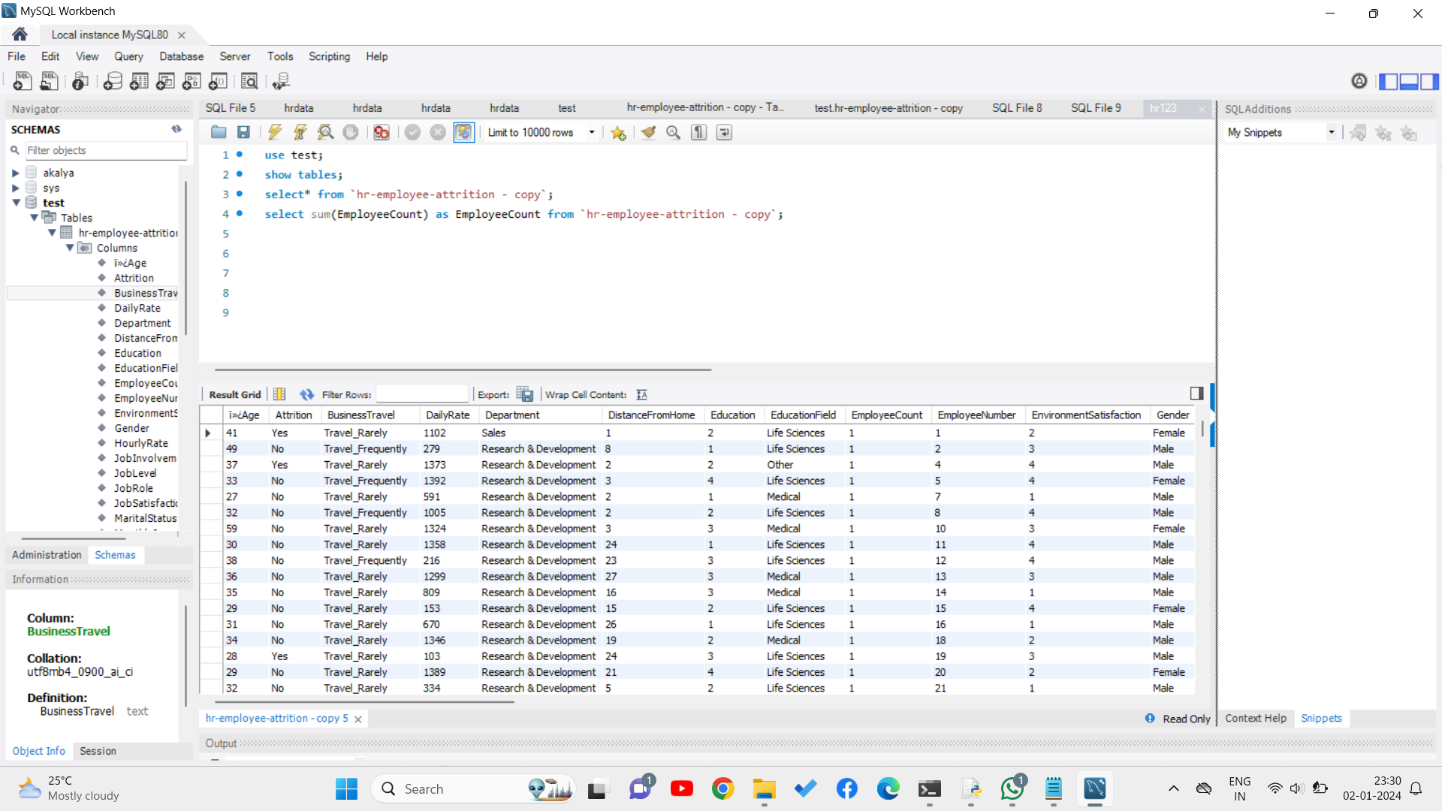

Slide 25
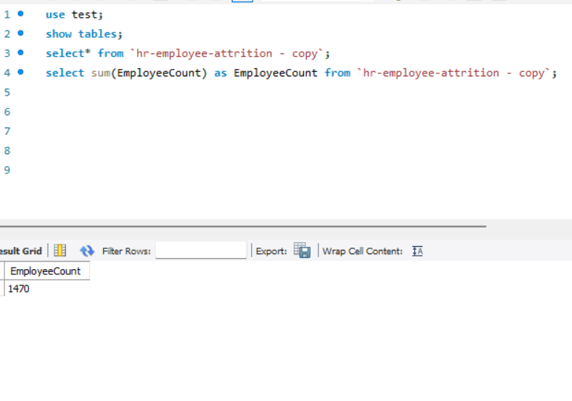

Slide 26
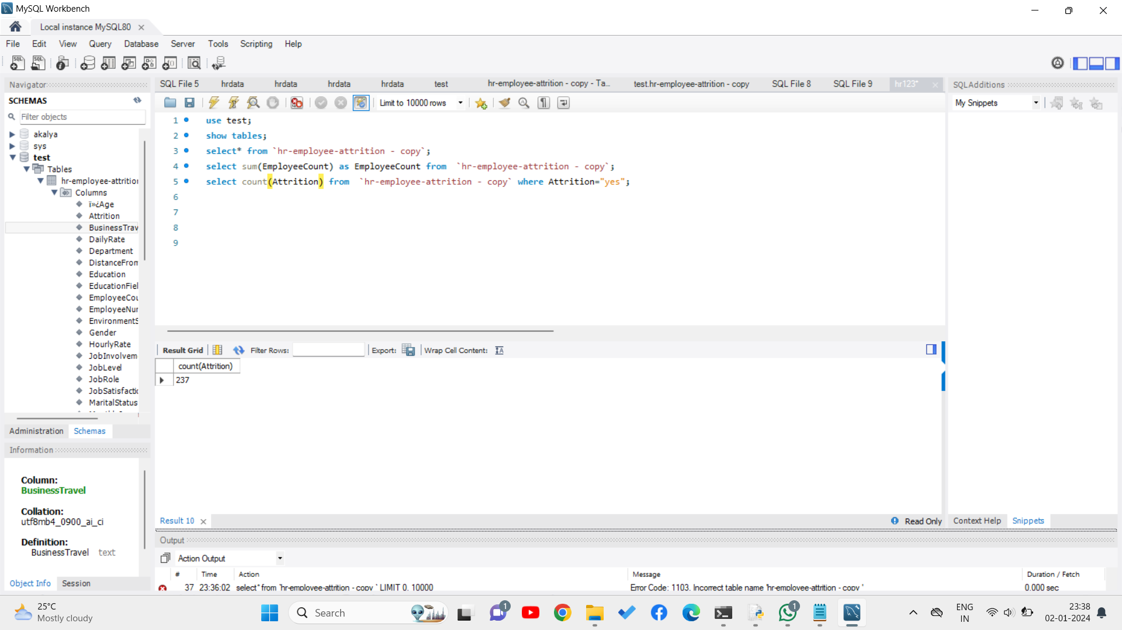

Slide 27
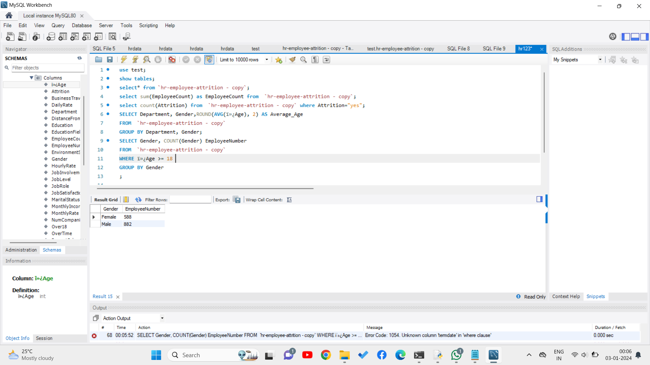

Slide 28
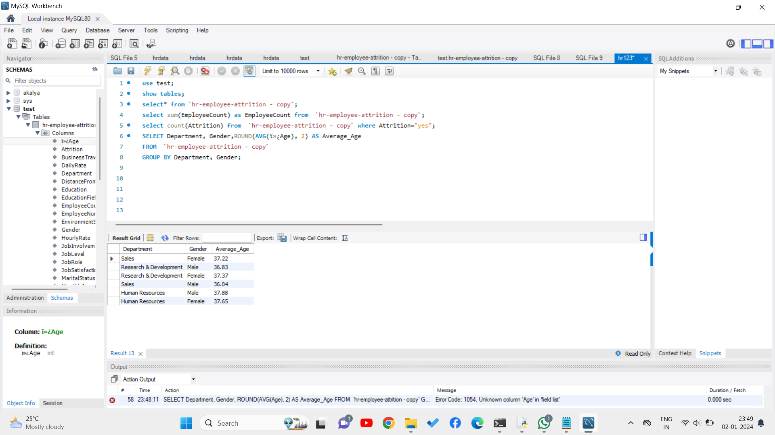

Slide 29
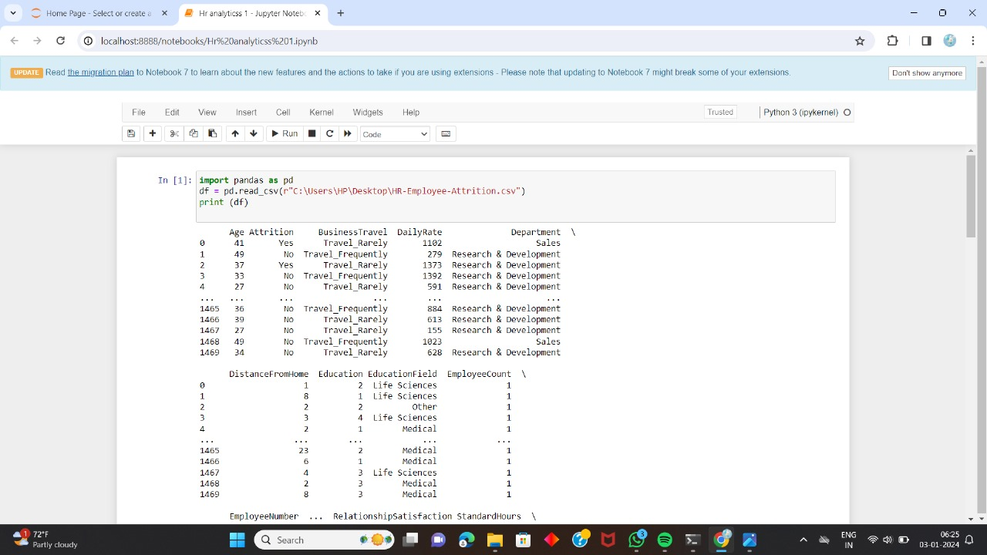
ML ALGORITHMS :

Slide 30
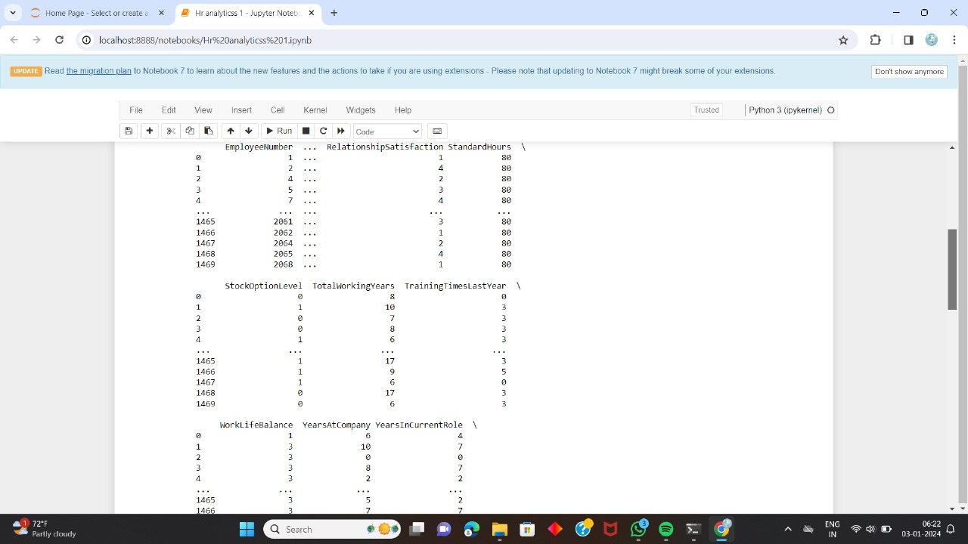

Slide 31
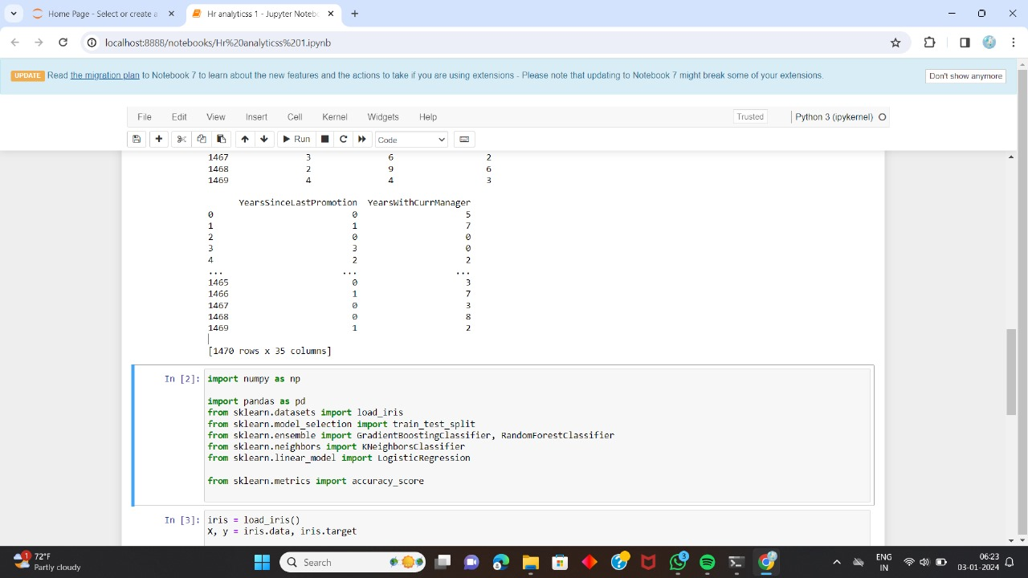

Slide 32
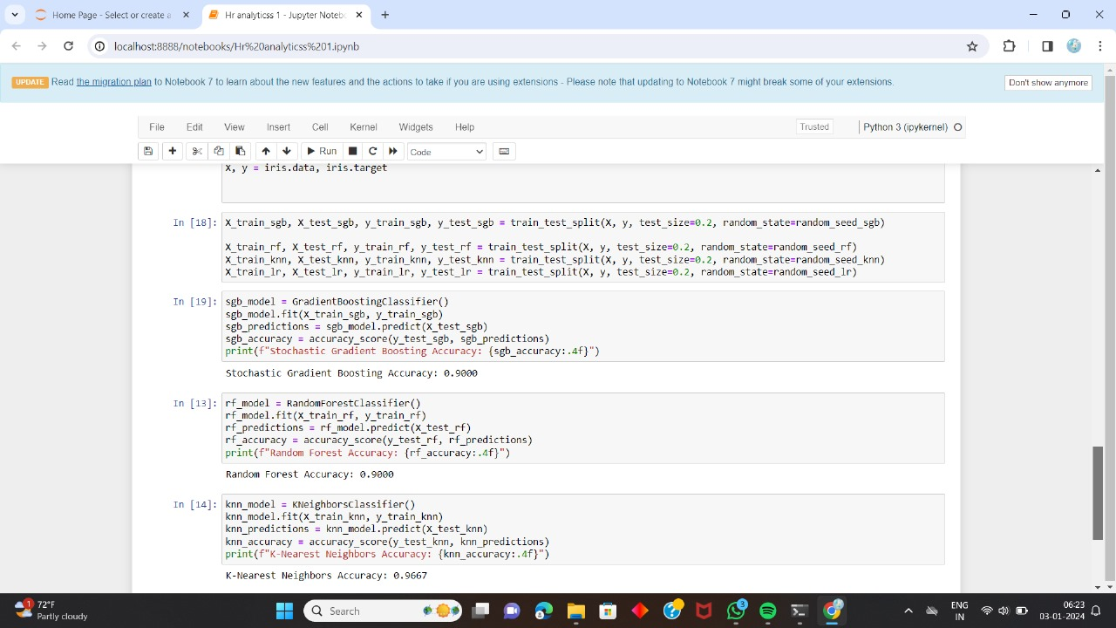

Slide 33
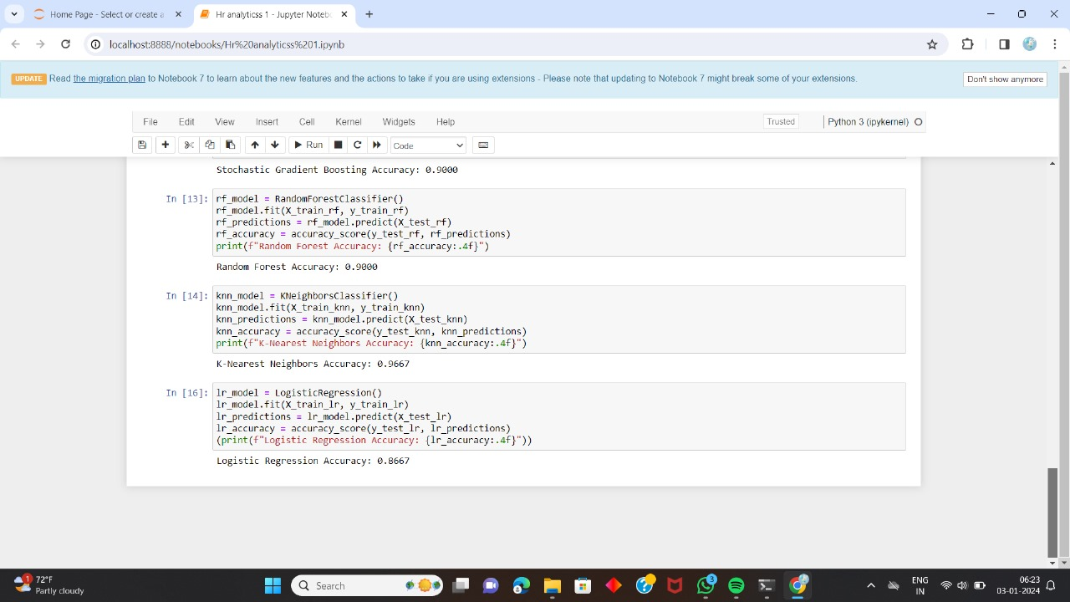

Slide 34
TOOLS REQUIREMENTS:
HARDWARE:
PROCESSOR : PENTIUM ||| 866 MHZ
RAM : 256 MB DD RAM
MONITOR : 15" COLOR
HARD DISK : 10GB
SOFTWARE:
Power BI
Tableau
Excel for data analysis
My SQL
python for ML

Slide 35
CONCLUSION:
The ability to extract meaningful insights from HR data is crucial for making informed decisions that positively influence employee engagement, organizational culture, and overall performance.
Human resource analytics has evolved significantly, leveraging technology to analyze vast amounts of data related to workforce management.
This evolution has empowered organizations to make data-driven decisions, optimize processes, and enhance overall performance.
By harnessing insights from employee data, companies can improve recruitment strategies, talent retention, and workforce productivity.

Slide 36
FUTURE SCOPE:
Predictive Analytics in Talent Acquisition:
Investigate how predictive analytics can be utilized to enhance talent acquisition processes. This could include predicting candidate success, optimizing recruitment channels, and minimizing time-to-fill metrics.
Employee Experience Analytics:
Explore the use of analytics to measure and improve the overall employee experience. This could involve analyzing engagement data, feedback from surveys, and other indicators to understand and enhance employee satisfaction and productivity.
People Analytics for Diversity and Inclusion:
Examine how analytics can be applied to monitor and improve diversity and inclusion within organizations. This might involve analyzing hiring practices, promotion rates, and employee engagement across different demographic groups.
Workforce Planning and Analytics:
Delve into how HR analytics can assist in strategic workforce planning. This could include predicting future skill gaps, identifying key talent for succession planning, and ensuring the organization has the right mix of skills for future needs

Slide 37
REFERENCES:
1.“SURVEY ON HR ANALYTICS USING POWER BI AND MACHINE LEARNING” by Prof. Ashvini Ganesh Bhosale, Ms. Rashmi Mrugank Shah, Ms. Ankita Anil Patil, Ms. Anisha Anil Khamkar in IEEE on 2023.
2.“RESEARCH ON HR ANALYTICS USING POWER BI AND MACHINE LEARNING” byProf. Ashvini Ganesh Bhosale, Ms. Rashmi Mrugank Shah,
Ms. Ankita Anil Patil, Ms. Anisha Anil Khamkar in IEEE on 2023.
3.HR Analytics and its Impact on Organizations Performance by Mr. Hritik Kale, Dr. Dilip Aher, Dr. Nilesh Anute in Research gate on 2023.
4.The roles of the HR function: A systematic review of tensions, continuity and change by Charles Cayrat, Peter Boxall in science direct on 2023.
5.To Study the Importance of HR Analytics Practicefor SMEs in NCR Region by Tanya Nagpal, Akhilesh Kumar Jaiswal, Boby Singh Panchal in open access on 2022.
6.Pressures for sustainability and strategic responses on employmentrelationships: The role of the HR manager by Mar Bornay-Barrachinaa, Jaime Guerrero-Villegasa, Macarena L. opez-Fern andez b,Margarita Ruiz-Rodrígueza in Science direct on 2022.
7.Human Resource Analytics using Power Bi Visualization Tool by Mohammad amir , Simhari and Suneetha manne published in IEEE on 2022.
8.How to leverage distributed data to create an HR 4.0 platform to support workforce management? A proposed solution based on three industrial contexts by Juliana Salvadorinhoa, Paulo Pintorb, José Moreirab, Marlon Freired, Nelson Ferreirad Leonor Teixeira in science direct on 2022.
9.Artificial Intelligence in Tactical Human Resource Management: A Systematic Literature Review by Alexis Megan Votto, Rohit Valecha, Peyman Najafirad, H. Raghav Rao in Science direct on 2021
10.HR disruption----Time already to reinvent talentmanagement by Lisbeth Claus in science direct on 2021

Slide 38


